Slide 1

Poverty & Housing in Chicago
Project Notes

Slide 2
PROJECT DESCRIPTION
The goal of the project is to determine how effective the city of Chicago has been in placing affordable housing in areas deemed of high poverty index since the 2008-2012 City of Chicago data.
The project will need the following;
Collection of data from a database
Method of navigation and filtering of the data
Presentation of filtered data in a dashboard
Charts
Heatmaps
Header
Mapping
Dashboard

Slide 3
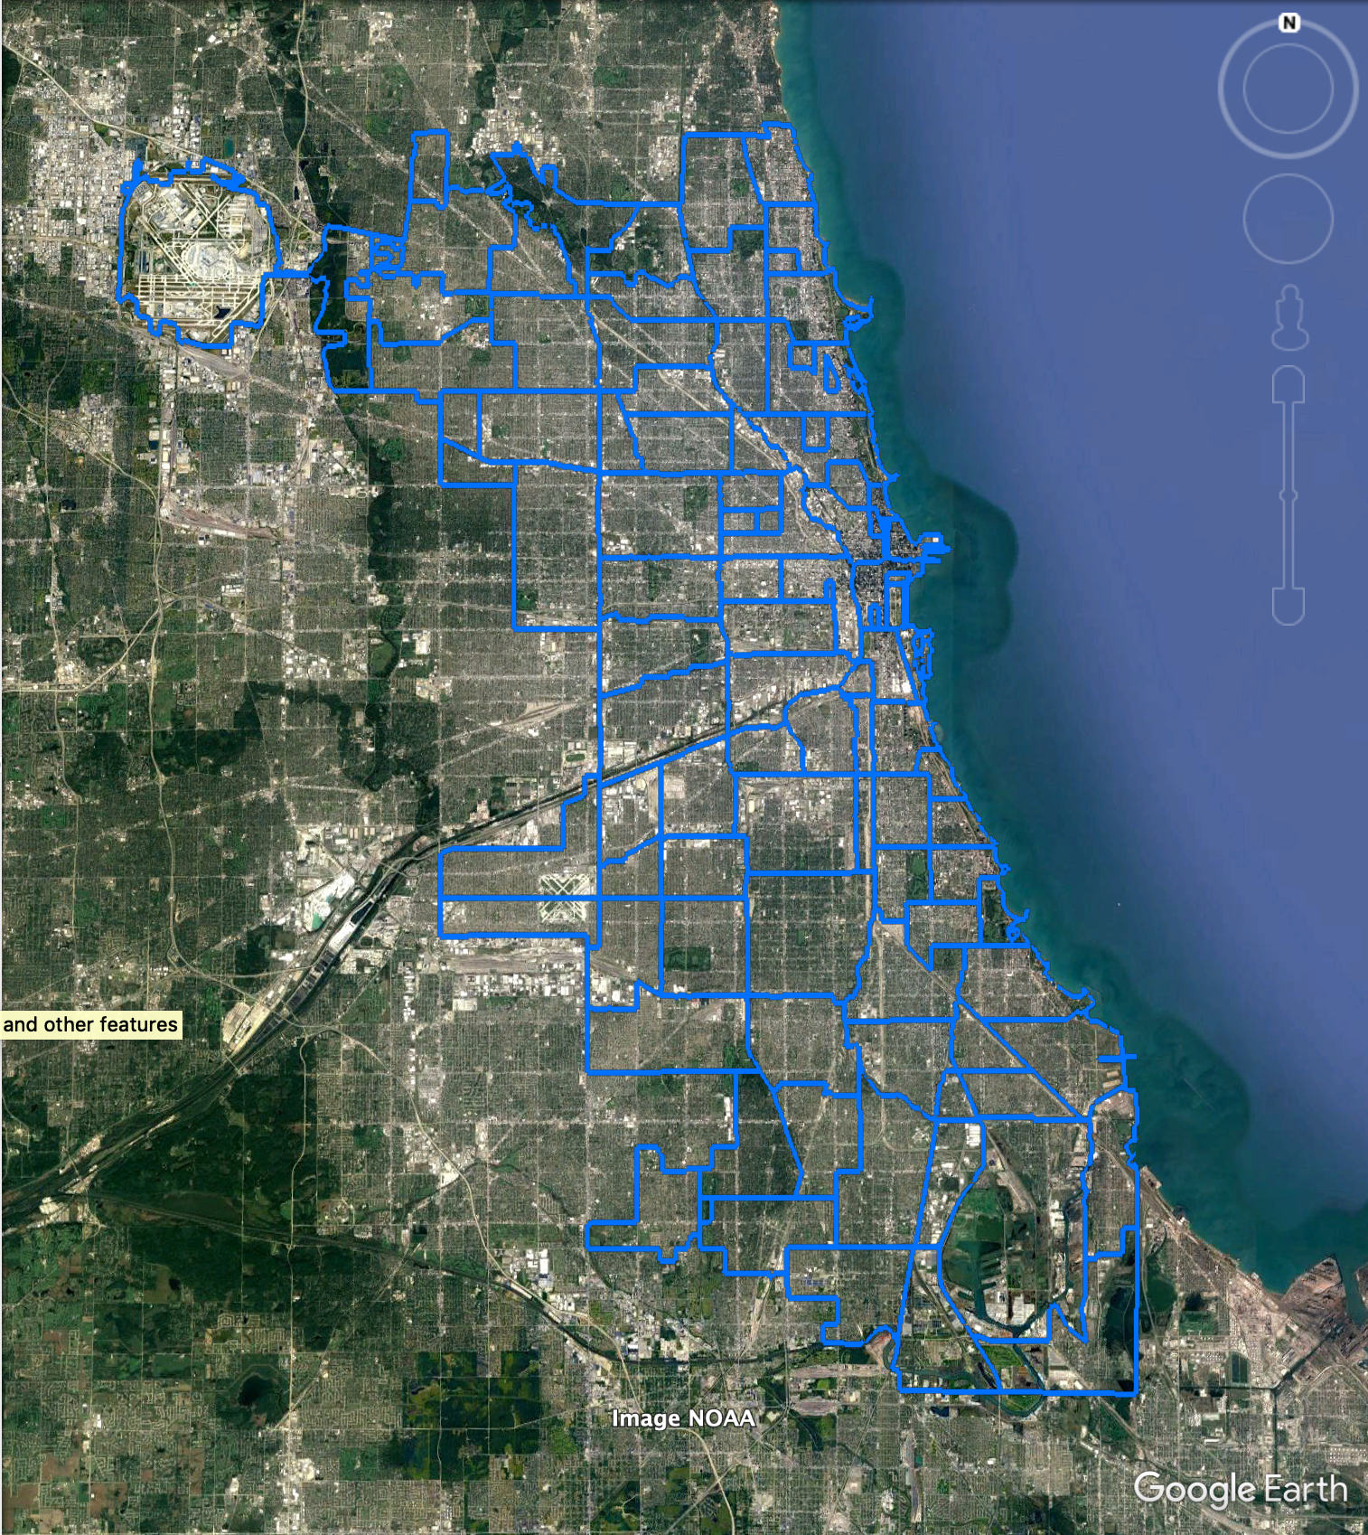
Map Plotting Concept
The KML data of Chicago neighbourhoods will be overlaid by default over the street map leaflet of Chicago.
The user may click within any of the neighbourhoods to filter the data shown in the dashboard to the selected neighbourhood
Clicking on the neighbourhood again will remove the applied filter
Clicking on another neighbourhood will switch the current filter to the newly selected neighbourhood
The user may show or hide a plot layer of the affordable housing developments
The user may show or hide a heat map layer indicating whether affordable housing was placed in a neighbourhood requiring it
Coefficient: (% crowded housing x % house below poverty)/units
A scale comprised of the min to max coefficient will be used to colour
Humboldt Park

Slide 4
Dashboard Concept
The leaflet/map plotting side will contain the following functionality;

Slide 5
Database Structure
The leaflet/map plotting side will contain the following functionality;

Slide 6
Map Plotting Work
Done | Description
 | Draw Map
 | Add KML Layer, Housing Layer
 | Make each neighbourhood an object
 | Add heatmap calculations to neighbourhood objects
 | Use neighbourhood objects as filter inputs
Humboldt Park

Slide 7
Datasets: Chicago DaTA PORTAL
DATA LOCATIONS ARE:
Affordable Housing:
https://data.cityofchicago.org/Community-Economic-Development/Affordable-Rental-Housing-Developments/s6ha-ppgi
API ENDPOINT: https://data.cityofchicago.org/resource/s6ha-ppgi.json
Hardship Indicators Census Data:
https://data.cityofchicago.org/Health-Human-Services/Census-Data-Selected-socioeconomic-indicators-in-C/kn9c-c2s2
API ENDPOINT: https://data.cityofchicago.org/resource/kc9i-wq85.json
Neighbourhood KML Data:
https://data.cityofchicago.org/Facilities-Geographic-Boundaries/Boundaries-Neighborhoods-KML/buma-fjbv

